Slide 1
CARDIAC RHYTHMS AND INTERVENTIONS
A STUDY GUIDE:

Slide 2
STUDY GUIDE
This Study Guide is to be used as a review to prepare you for the annual EKG Competency.
This Study Guide provides the basics of EKG Interpretation and should be used to enhance your learning and prompt you to seek other resources. This Study Guide is not designed as the initial learning for EKG Interpretation.

Slide 3
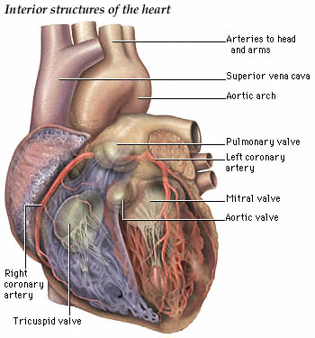
THE HEART

Slide 4
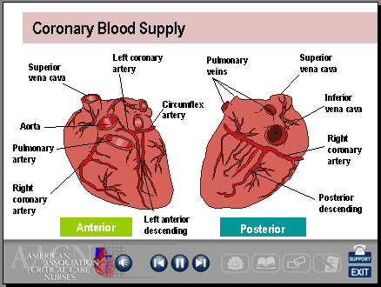

Slide 5
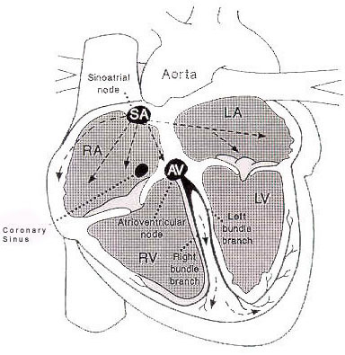
THE CONDUCTION SYSTEM

Slide 6
SOME OF THE BASICS TO KNOW
The ability of a cell to initiate an impulse without outside stimulation is called ________________.
The movement of a wave of negative charges which results in relaxation is called ______________.
The mechanical events of the heart are _______and _______________.
The primary pacemaker of the heart is the_________.
The rate of the AV Node is _________
The rate of the Purkinje Fibers is:____________.
Answers located on Page 41

Slide 7
REVIEW
If the SA node fails, there are 2 other pacemakers that can take over. These pacemakers are the _________ and the ______
Arrange numerically (1 through 5) the Normal conduction system of the heart
  _______Purkinje Fibers
  _______SA Node
  _______Bundle of His
  _______AV Node
  _______Right and Left Bundle Branches
  Answers located on Page 42

Slide 8
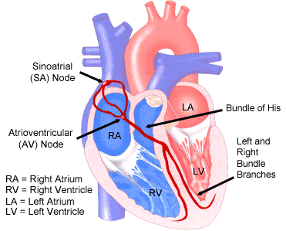
BUNDLE BRANCH BLOCK

Slide 9
REVIEW
Depolarization of the atria is represented on the EKG as the ________.
Depolarization of the ventricles is represented on the EKG as the______.
A normal PR Interval measures: _______________
The QT Interval is measured from the ___________to the___________.
A normal QRS Interval measures:_________.
Answers located on Page 43

Slide 10
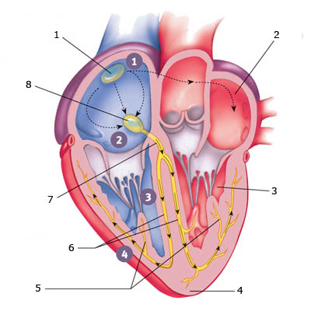
CAN YOU CORRECTLY IDENTIFY THE CONDUCTION SYSTEM?
1____________
2____________
3____________
4____________
5____________
6____________
7____________
8____________
Answers located on Page 10

Slide 11
CONDUCTION SYSTEM ANSWERS
1 : SA NODE
2 : LEFT ATRIUM
3 : LEFT VENTRICLE
4 : APEX
5 : PURKINJE FIBERS
6 : BUNDLE BRANCHES
7 : AV BUNDLE
8 : AV NODE

Slide 12
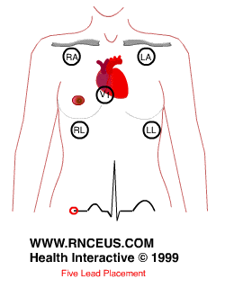
5-LEAD ELECTRODE PLACEMENT
Make sure your leads are in correct position, adhere securely to the skin, and not obstructed by other drains and dressings. Assure that your EKG rhythm is clear, readable, and free of artifact.

Slide 13
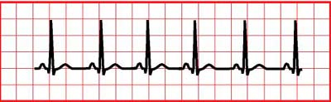
CALCULATING ACCURATE HEART RATES
CALCULATING A HEART RATE WITH A REGULAR RHYTHM:
  Measure R to R Interval. Divide # of small boxes into 1500 (remember: there are 5 small boxes in each large box on the EKG Rhythm Strip). This is your heart rate.
  There are alternate methods for determining heart rates in a regular rhythm that are acceptable including, the “300” method.

Slide 14

CALCULATING ACCURATE HEART RATES
  CALCULATING A HEART RATE WITH AN IRREGULAR RHYTHM
    Irregular rhythms, such as atrial fibrillation, do not measure a constant rate (i.e., there is a range in the rate of the ventricular response). When interpreting, you should calculate a range of ventricular rate, the slowest heart rate (R to R) to the fastest heart rate (R to R interva
    COUNTING THE NUMBER OF QRS’S IN A 6-SECOND STRIP AND MULTIPLYING BY 10 TO OBTAIN A HEART RATE IS NOT AN ACCURATE METHOD TO DETERMINE A HEART RATE OF AN IRREGULAR RHYTHM!!!
Atrial Fibrillation

Slide 15
BASIC STEPS TO RHYTHM INTERPRETATION
Is there a P wave present? Is it upright? Is there 1 P Wave to each QRS? Do all the P waves look similar to each other?
Is the rhythm regular or irregular: is the P to P and R to R occurring at regular intervals?
What is the rate: atrial and ventricular
Measure the PR Interval: Greater than 0.20 seconds?
Measure the QRS Interval: Greater than 0.10-0.12 seconds?
If you have these answers, you can interpret your patient’s basic heart rhythm

Slide 16
DOCUMENTATION
All rhythm strips must be reviewed, verified, and signed by the nurse (this is in addition to the Cardiac Monitoring Technician’s (CMT)interpretation).
    If the interpretation matches, the RN will sign (name, title, employee identification number (EID), date, time) the cardiac monitoring strip.
The RN signature indicates the RN assessment and interpretation match with the CMT reading.
    Documentation on all strips should include: PR, QRS, QT Intervals, rates, interpretation, and verification of alarms.
If the RN assessment and interpretation is different from the CMT reading of the cardiac monitoring strip, the RN will:
    record their interpretation and will sign (name, title, EID, date, time) the cardiac monitoring strip.

Slide 17
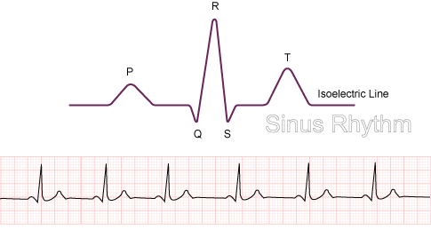
THE EKG COMPLEX
JPoint
What is the J Point? The point where the QRS complex ends and the ST segment begins

Slide 18
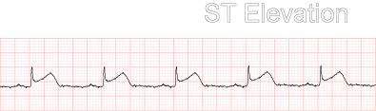
ST ELEVATION
ISOELECTRIC LINE
ST Segment begins at the J Point and ends at the beginning of the T wave. What should you be assessing for? >2mm elevation or greater than 2 small boxes from the isoelectric line in 2 or more leads facing the same direction (i.e., chest leads--the 12 Lead EKG will provide more information about ST elevation or depression)

Slide 19

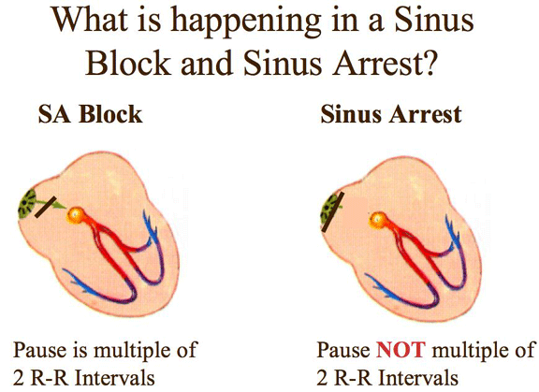
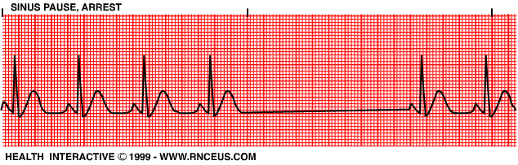
SINUS DYSRHYTHMIAS
Sinus Arrhythmia: A Sinus Rhythm with an irregular R-R Interval and a varying heart rate. Most common cause is one’s breathing pattern.
Sinus Pause/Arrest: Underlying rhythm is regular. Loss of the SA Node to fire

Slide 20
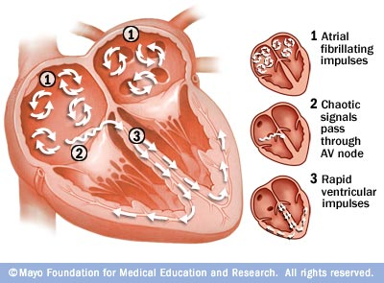
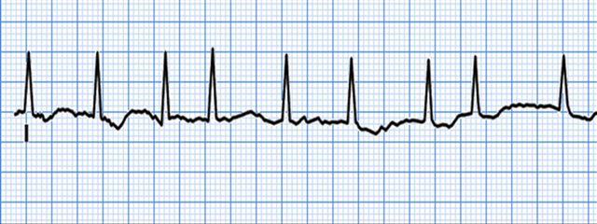
ATRIAL FIBRILLATION
Characteristics of atrial fibrillation:
Rapid firing (or quivering) of the atria
Irregular ventricular response:
May be fast or slow
Inability to pump out all of the blood from the atria resulting in blood pooling, increasing incidence of clot formation.
Baseline rhythm is wavy, no specific p waves visible
Condition may be chronic or acute

Slide 21

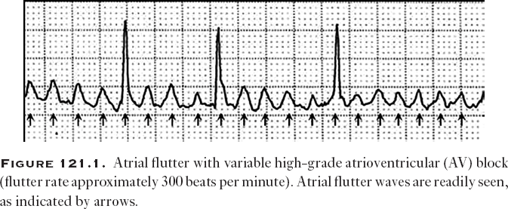
ATRIAL FLUTTER
Atrial Flutter characteristics:
Saw-Tooth Pattern of atrial waves
Re-entry disturbance frequently involving the right atrium
Rapid atrial rate
Ventricular response may vary resulting in a 2:1, 3:1, or greater block
Treatment: Rate control with medications (beta blockers), cardioversion, or ablation
2:1 Atrial Flutter

Slide 22

JUNCTIONAL RHYTHMS
Rhythm: Rates:
Regular
Junctional 40-60/mn
Accelerated Junction 60-100/mn
Junctional Tachycardia >100/mn
Look for changes in the appearance of the P waves: May be absent, inverted, within, or after the QRS Complex
Cause: Conduction Abnormality; the AV Node takes over the initiation of the impulse in place of the SA Node

Slide 23


HEART BLOCKS
1st degree heart block
Prolongation of PR Interval >0.20 seconds. Actions are:_______
2nd degree HB Type I
Also called “Wenkebach”
Progressive Lengthening of PR Interval until a p wave appears with no QRS behind it (representing the blocked beat at the AV Node. Actions are: ______________.

Slide 24


HEART BLOCKS
Second Degree Heart Block Mobitz Type II
Constant PR Interval with conducted beats (QRS) and non-conducted or blocked p waves identified as no QRS behind the p wave)
Third Degree Heart Block
No relationship exists between the p wave (atrial impulse) and the QRS (ventricular impulse), i.e., a complete dissociation. Measure the p to p and r to r and it is generally regular to each other. Atrial rate is typically faster than ventricular rate. QRS might or might not be wide. The width of the QRS helps to determine exactly where the site of the block is occurring
Treatment of choice: Pacemaker

Slide 25
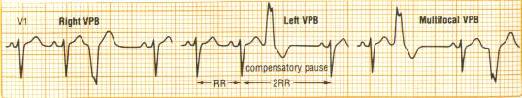

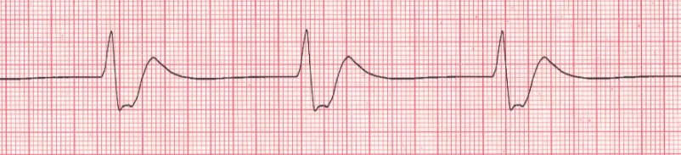


VENTRICULAR ARRHTHMIAS
Premature Ventricular Contractions
Ventricular Tachycardia: 3 categories: Stable, Unstable, or Pulseless. Treatment based on the category. Stable: antiarrhythmics, Unstable: Cardiovert, PulseLess: Defibrillation
IdioVentricular Rhythm: rhythm of the ventricles 20-50/mn, wide QRS
Ventricular Fibrillation
Treatment: Defibrillation, CPR, Epinephrine or Vasopressin, and antiarrhythmics
Torsades de Pointes: a rapid ventricular tachycardia with twisting of the QRS Complex around the baseline. Check the Mg Level; also associated with Long QT Syndrome

Slide 26
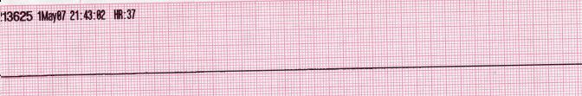
ASYSTOLE
Asystole: Absence of any cardiac activity
What are your first steps should you see this rhythm?
Check your patient and check the patient’s EKG leads. Assure that the patient is asystole, check the patient’s pulse and check the rhythm in an alternate lead
Still asystole? Start CPR and call a Code
Consider possible causes that may be reversible
Management and Treatment:
CPR
Epinephrine

Slide 27
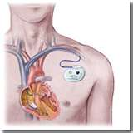
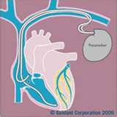
PACEMAKERS
Always check out what type of pacemaker your patient has. Is it VVI (Paces the ventricles, Senses in the ventricles, and action is Inhibited) or is it a Dual Pacemaker, pacing and sensing both the Atria and the Ventricles. Also does it have capability of Cardioversion and/or Defibrillation.
Pacemaker
Atria
Ventricle

Slide 28
PACEMAKERS
Actions: Paces, Senses, and responds (Triggered) or may be Inhibited (i.e., pacemaker will fire if heart rate falls below or above set rate on pacemaker.
  Triggered Pacemaker: pacemaker has a fixed rate and fires at that rate continuously regardless of patient’s underlying cardiac activity
  Inhibited Pacemaker: pacemaker fires only when needed; a demand-type pacemaker; they inhibit their stimulus when they sense the patient’s cardiac activity
Additional Actions of a pacemaker may include ability to cardiovert and defibrillate

Slide 29
WHY A PACEMAKER?
Pacemakers: Often placed for symptomatic bradycardia, blocks, or SA Node Failure
Bi-Ventricular Pacemakers: placed for Heart Failure, with or without bradycardia
Defibrillators/Cardioversion: recurrent SVT and VT rhythms
Bi-Ventricular Defibrillators: for combination treatment of Vtach/Vfib and Heart Failure

Slide 30
Codes to determine the type of pacemaker your patient has.
Chamber Paced: V=Ventricle A=Atria D=Dual Chamber S=Single Chamber O=None
Chamber Sensed: V=Ventricle A=Atria D=Dual Chamber S=Single Chamber O=None
Mode of Response: T=Triggered I=Inhibited D=Dual (both) O=None
Programmable/Rate Response: P=Programmable M=Multiprogrammable C=Communicating R=Rate Responsive O=None
Arrhythmia/Anti-tachycardia Control: ICD S=Shock P=Pace
Examples: VVI Pacemaker is paced in the ventricles, sensed in the ventricles, and mode is inhibited
DDD: Dual Pacing, Dual Sensing, Dual Inhibition
Compared to a DVI: Dual Pacing, only the Ventricle Senses, and only Ventricle is inhibited

Slide 31
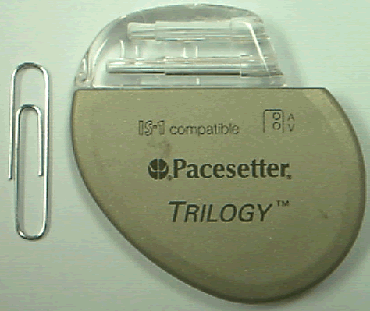
POSSIBLE PACEMAKER PROBLEMS
Failure to Capture: pacemaker fires but no capture occurs; on the EKG you will see a pacemaker spike not followed by a complex
Battery Failure: Complete absence of pacemaker spikes in a rhythm that would normally be paced. Current lithium batteries generally last anywhere from 5-10 years, dependent on amount of pacing required.
Under-sensing: Lack of sensing by the pacemaker results in a competition between the paced rhythm and the patient’s intrinsic rhythm. Causes: lead placement, lead dislodgement, drug therapy, myocardial infarction, low amplitude, programming of the sensitivity

Slide 32
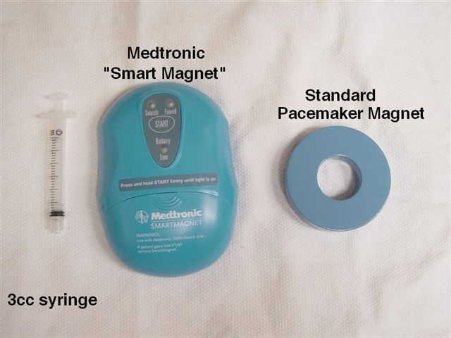
Temporary Placement of a magnet over a permanent pacemaker can “reprogram” the pacer into an asynchronous mode.
It does not turn the pacer off but can determine if the battery needs replacement. This is performed by the physician!
USE OF A MAGNET

Slide 33
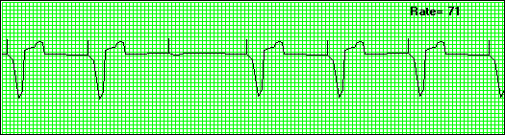
PACED RHYTHM
The rhythm above is: _______________________.
Your actions are:
Answers located on Page 45

Slide 34
USE OF CARDIAC-VASOACTIVE DRIPS
Can you give a cardiac drip on your unit? Not sure?
Resources:
  Charge Nurse
  Nurse Manager
  Institutional Policy:
    ADULT CARDIAC MEDICATION MONITORING GUIDELINES #CLN0500
    OR
  Go to Clinical Resources, Clinic Portal, Pharmacy and Formulary – Lexicomp Online
  Search the term Guidelines
  Click on Adult Cardiac Medication Monitoring Guidelines

Slide 35
SOME COMMON CARDIAC IV MEDICATIONS TO TREAT CARDIAC ARRHYTHMIAS
Atrial Fibrillation
  Cardizem
  Amiodarone
  Ibutilide: PHYSICIAN MUST BE AT BEDSIDE.
SVT
  Adenosine: PHYSICIAN MUST BE AT BEDSIDE

Slide 36
MATCH THE FOLLOWING
1. __Cardioversion A. Rhythm with inverted p wave, rate 80
2.__ Sick Sinus Syndrome B. Used for treatment of SVT
3.__ PEA C. Irregular rhythm with p waves present,
4.__ Hypokalemia D. Pacer spike not accompanied with a complex
5.__Accelerated Junctional Rate E. Diltiazem
6.__ Ventricular depolarization F. Intrinsic rate of Purkinje Fibers
7.__ Injury G. Used in unstable rapid atrial fibrillation
8. __ Adenosine H. ST depression or flat ST segment
I. Class III antiarrhythmic for atrial fib
9. __ Hyperkalemia J. BradyTachy Syndrome
10.__Sinus Arrhythmia K. Wide QRS, no p waves, generally <40/mn
11.__Calcium Channel Blocker L. QRS Complex
12.__ Failure to Capture M. Tall Peaked narrow T waves
13.__IdioVentricular Rhythm N. Flat T wave, U wave, ST depression
14._ Ischemia O. ST elevation
15.__20-40 beats/minute P. Rhythm seen on monitor; no pulse present
16. __Ibutilide Q. Metoprolol
R. 60-100 beats/minute
S. P Wave
*Note: There are more responses in 2nd column than in the 1 st column, so you may not use all the responses!!!
Answers located on Page 46

Slide 37
CARDIAC MONITORING UNIT
CMU: provides continuous cardiac and pulse oximetry monitoring
Contact Number is: 3-1599
Remember to contact the CMU:
  If removing the patient from the monitor
  New admissions to the monitor

Slide 38
ALARMS
EKG Alarms remain ON and audible at all times
Alarm Rate Settings are set based upon Adult Cardiac Monitoring Admission or Transfer Order Set

Slide 39
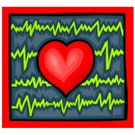
PATIENT EDUCATION
Patient Education should include:
  Explanations:
    The purpose for cardiac monitoring
    What the monitor will inform
    Alarms
    Ambulating with the monitor

Slide 40
AVAILABLE WEB SITES FOR PRACTICE WITH EKG RHYTHMS AND INFORMATION
http://www.skillstat.com/learn.htm
http://www.gwc.maricopa.edu/class/bio202/cyberheart/ekgqzr.htm
http://www.practicalclinicalskills.com/ekg.aspx
http://www.ecglibrary.com/ecghome.html
http://en.ecgpedia.org/wiki/Main_Page

Slide 41
ANSWERS, pg 6
The ability of a cell to initiate an impulse without outside stimulation is called automaticity
The movement of a wave of negative charges which results in relaxation is called repolarization.
The mechanical events of the heart are Systole and Diastole
The primary pacemaker of the heart is the SA Node.
The rate of the AV Node is 40-60/mn.
The rate of the Purkinjee Fibers is 20-40/mn.

Slide 42
ANSWERS, pg 7
Additionally, if this node above fails, there are 2 other pacemakers that can take over. These pacemakers are the AV Node and the Purkinje Fibers.
Arrange numerically (1 through 5) the Normal conduction system of the heart
  5 Purkinje Fibers
  1 SA Node
  3 Bundle of His
  2 AV Node
  4 Right and Left Bundle Branches

Slide 43
ANSWERS, pg 9
Depolarization of the atria is represented on the EKG as the P wave.
Depolarization of the ventricles is represented on the EKG as the QRS
A normal PR Interval is 0.12-0.20 seconds.
The QT Interval is measured from the beginning of the Q wave to the end of the T Wave.
A normal QRS Interval is 0.04-.10 seconds.

Slide 44
ANSWERS, pg 17
Prolongation of PR Interval >0.20 seconds. Actions are: Monitor, Assessment, BP Monitoring.
Prolongation of PR Interval >0.20 seconds. Actions are: Monitor, assessment, BP monitoring.

Slide 45
ANSWERS, pg 33
The rhythm above is a Ventricular Paced_rhythm with one beat which is failure to capture. Your actions are:
assess the patient, check Vital Signs, be sure you know what type of pacemaker device and the settings your patient has. You can find this information generally in the medical record or under Cardiology section.
Notify MD/Cardiologist to anticipate interrogation of pacemaker

Slide 46
ANSWERS, pg 24
1. G Cardioversion A. Rhythm with inverted p wave, rate 80
2.. J Sick Sinus Syndrome B. Used for treatment of SVT
3. P PEA C. Irregular rhythm with p waves present
4. N Hypokalemia D. Pacer spike not accompanied with a complex
5. R Accelerated Junctional Rate E. Diltiazem
6. L Ventricular depolarization F. Intrinsic rate of Purkinje Fibers
7. O Injury G. Used in unstable rapid atrial fibrillation
8. B Adenosine H. ST depression or flat ST segment
I. Class III antiarrhythmic for atrial fib
9. M Hyperkalemia J. BradyTachy Syndrome
10. C Sinus Arrhythmia K. Wide QRS, no p waves, generally <40/mn
11. E Calcium Channel Blocker L. QRS Complex
12. D Failure to Capture M. Tall Peaked narrow T waves
13. K IdioVentricular Rhythm N. Flat T wave, U wave, ST depression
14. H Ischemia O. ST elevation
15. F 0-40 beats/minute P. Rhythm seen on monitor; no pulse present
16. I Ibutilide Q. Metoprolol
R. 60-100 beats/minute
S. P Wave
*Note: There are more responses in 2nd column than the first column. So you will not use all the answers!

Slide 47
REFERENCES
Aehlert, B. (2006). ECGs made easy. St. Louis, MO: Mosby Elsevier.
Dubin, D. (2000). Rapid interpretation of EKG’s Tampa, FL: Cover Publishing
Garcia, T., & Miller, G. (2004). Arrhythmia recognition: The art of interpretation. Sudbury, MA: Jones
and Bartlett.
Huszar, R. (2002). Basic dysrhythmias: Interpretation and management. St. Louis, MO: Mosby.
Iannuzzi, M. (Ed.) (2010). Core Curriculum for Progressive Care Nursing. St. Louis, MO:
Saunders Elsevier.
Sinz, E., Navarro, K, & Soderberg, E. (Eds.) (2011). Advanced cardiovascular life support: Provider
manual. United States: American Heart Association.
Walraven, G. (1999). Basic arrhythmias. Uper Saddle River, NJ: Prentice Hall.
Related Institutional Policies
Adult Cardiac Medication Monitoring Guidelines (UTMDACC Institutional Policy # CLN0500).
Clinical Alarms Policy (UTMDACC Institutional Policy # ADM0173).
Adult Cardiac Monitoring Admission and Discharge Policy (UTMDACC Institutional Policy #CLN0511).
Central Monitoring (CM) for the Emergency Center and Inpatient Units Outside the Intensive Care Unit(ICU) and Post Operative Care Unit(PACU) Policy (UTMDACC Institutional Policy # CLN1031).
Related Institutional Order Sets
Adult Cardiac Medication Admission or Transfer Inpatient
Adult Cardiac Monitoring Renewal or Discontinuation Inpatient
Atrial Fibrillation/Atrial Flutter Pharmacologic Treatment (Telemetry) Inpatient
Mosby’s Skills®
Cardiac Monitor Setup and Lead Placement

